Slide 1

Religion & Conflict Revision
A RE lesson created by Mr Betts

Slide 2




Starter
A*
A
To apply religious teachings/vocabulary effectively to improve upon my exam answers
Complete the key word worksheet
To communicate my opinion clearly and use some religious vocabulary in my answers
B
C
To know key terms for the unit and give my personal opinion about important issues

Slide 3
A*
A
To apply religious teachings/vocabulary effectively to improve upon my exam answers
The Key Term | The meaning of the term is…
Reconciliation_________________ | Making up and saying sorry after a quarrel or dispute and working together again. Example: Forgiving each other.
Conflict_________________ | Clashes and breakdown of relationships. Example: Fighting. E.g. Disputes between countries over land
Non-Violent Protest_________________ | Showing disapproval without damaging property or using any violence. Example: Marching/Petitions
Pacifism_________________ | The belief that any form of violence or war is unacceptable. Example: Refusing to fight in wars
Just War_________________ | A war that can be justified according to certain conditions. Example: A good cause/the last resort
Interfaith Dialogue_________________ | Exploring common grounds between different faith groups. Often to achieve peace e.g. Corrymeela in Northern Ireland
B
To communicate my opinion clearly and use some religious vocabulary in my answers
C
To know key terms for the unit and give my personal opinion about important issues
Notes:
Higher ability clues to complete without any help! Have just dictionaries available

Slide 4

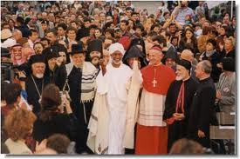
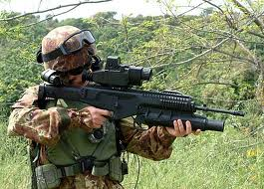



Slide 5



Ormiston Venture Academy Humanities Faculty
TOPIC: Revision Lessons
TITLE: ‘Religion & Conflict’ Revision
Previous Learning: (Revision lesson 1 – Key terms)
To understand and apply religious teachings/vocabulary effectively to improve upon my exam answers
Learning Outcomes
A*-A
The outcome of today's learning will be: To check our understanding of key terms and apply these to exam answers. Improve our Question E answering by developing clear opinions about issues
To be able to communicate my opinion about issues clearly and use some religious vocabulary in my answers
B
To know key terms for the unit and give my personal opinion about issues surrounding conflict
Learning Activities
C
Key word starter
Applying key words to answers
Table discussions
Answering E questions
Assessment of Learning
Q&A, Class discussion
Key word check
Written work, Peer assessment

Slide 6




A*
A
To apply religious teachings/vocabulary effectively to improve upon my exam answers
Here is an answer to a B Question worth 4 marks.
B) Explain Christian attitudes towards war (4)
Christians believe that war can sometimes be acceptable if it is a just war. For example fighting for freedom or in defense. However some Christians are very against any form of violence and are pacifists because Jesus said they should be ‘peacemakers’ in the world and “those who live by the sword die by the sword”. Therefore disagreements could be sorted out by speaking to one another peacefully to avoid violence such as reconciliation.
B
To communicate my opinion clearly and use some religious vocabulary in my answers
C
To know key terms for the unit and give my personal opinion about important issues
Notes:
For those aiming for a B grade

Slide 7

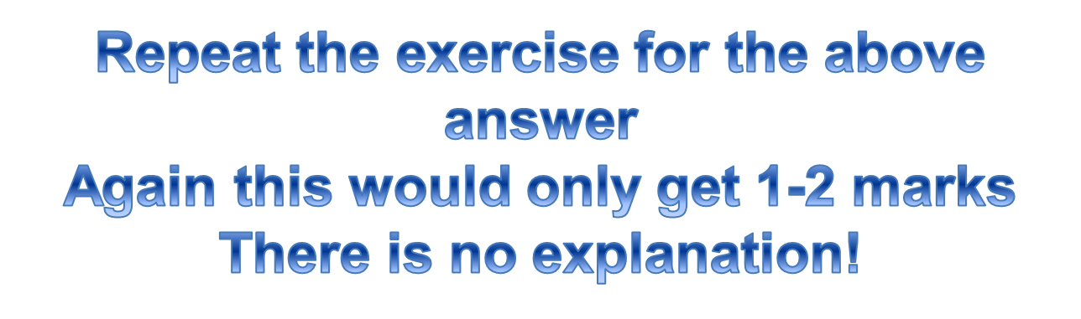
To apply religious teachings/vocabulary effectively to improve upon my exam answers
A*
A
Here is an answer to a B Question worth $ marks.
B) Explain religious attitudes towards inter-faith dialogue (4)
Interfaith Dialogue is useful to find common ground between different religions. For example, a fundamental teaching in most religions, teaches people to be peaceful. In this most religions believe that people should be treated equally and in conflict to not use violence. For example: The conflict between Catholics and Protestants in Ireland could be solved with an Interfaith Dialogue.
To communicate my opinion clearly and use some religious vocabulary in my answers
B
C
To know key terms for the unit and give my personal opinion about important issues
Notes:
For those aiming for a B grade

Slide 8


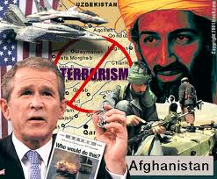
To apply religious teachings/vocabulary effectively to improve upon my exam answers
A*
A
To communicate my opinion clearly and use some religious vocabulary in my answers
B
C
To know key terms for the unit and give my personal opinion about important issues
Notes:
http://www.youtube.com/watch?v=O7sC_0yXWHo&feature=relmfu

Slide 9

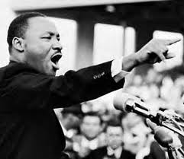

Names | Agree or Disagree | Reason/s
Oresta | Agree | In the middle.
Sachu | Agree | Life will be better.
Me (Kurt) | Agree | There should not be violence, then we will not have war.

Slide 10
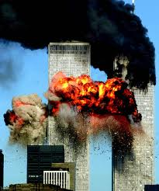
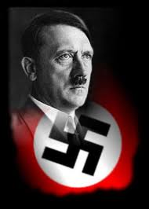
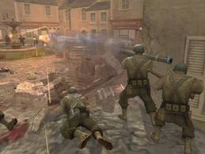
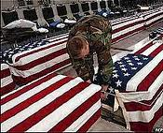
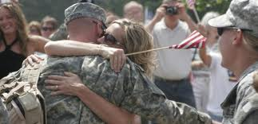

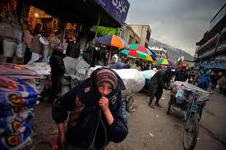

A*
A
To apply religious teachings/vocabulary effectively to improve upon my exam answers
B
To communicate my opinion clearly and use some religious vocabulary in my answers
C
To know key terms for the unit and give my personal opinion about important issues
Notes:
Give pictrues guess the topic, key words, spelt wrong,
Example answer leave key words out – apply the key wrods the answer to improve it

Slide 11

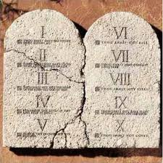



To apply religious teachings/vocabulary effectively to improve upon my exam answers
A*
A
“Love one another”
“Thou shalt not kill”
Violence leads to more violence. Our words speak louder than actions
“Greater love has no man that laying down his life for his friend”
Like Jesus did for humanity
To communicate my opinion clearly and use some religious vocabulary in my answers
Innocent people should not be killed. Peace must be achieved
B
“Love your enemies and pray for those who persecute you”
C
To know key terms for the unit and give my personal opinion about important issues
Muslims believe in holy war to defend their religion when under attack
Aquinas created criteria that Christians consider good enough reason for go to war e.g. a last resort
Notes:
For those aiming for an A grade

Slide 12

A*
A
To apply religious teachings/vocabulary effectively to improve upon my exam answers
“Everyone should be a pacifist” Do you agree? Give reasons for your opinion and refer to a religious point of view in your answer (8)
WHAT & AGREE | I agree/disagree/partly agree and disagree with this statement, although I understand why others may agree/disagree (Circle your choice)
WHY | My reason is… I believe that pacifism is a good thing as it stops violence, although it will remove a vital instinct of our personality, this will stop us from achieving many things. Another reason is…
ON THE OTHER HAND | Christians believe… Others might say…
SO | In conclusion…
B
To communicate my opinion clearly and use some religious vocabulary in my answers
C
To know key terms for the unit and give my personal opinion about important issues
Notes:
Lower ability sheet

Slide 13

A*
A
To apply religious teachings/vocabulary effectively to improve upon my exam answers
“Everyone should be a pacifist” Do you agree? Give reasons for your opinion and refer to a religious point of view in your answer (8)
WHAT & AGREE | I agree/disagree/partly agree and disagree with this statement, although I understand why others may agree/disagree (Circle your choice)
WHY | (give two different reasons for your opinion, use examples appropriately)
ON THE OTHER HAND | (explain Christian teachings and beliefs about the issue, include alternative views and relevant key vocabulary)
SO | (say what you think overall after considering a range of viewpoints)
B
To communicate my opinion clearly and use some religious vocabulary in my answers
C
To know key terms for the unit and give my personal opinion about important issues
Notes:
Lower ability sheet

Slide 14

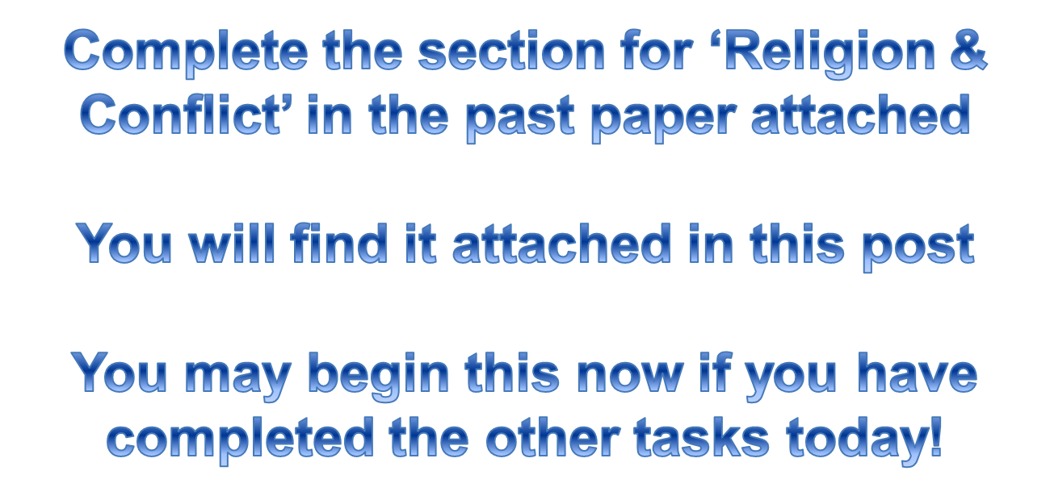
Home learning
To apply religious teachings/vocabulary effectively to improve upon my exam answers
A*
A
To communicate my opinion clearly and use some religious vocabulary in my answers
B
C
To know key terms for the unit and give my personal opinion about important issues
Notes:
Lower ability sheet

Slide 15
Plenary: Peer-Assessment
A*
A
To apply religious teachings/vocabulary effectively to improve upon my exam answers
Level | Level Descriptor | Mark
0 | Makes no relevant point of view | 0
1 | A simple point of view, possibly linking a connection between teaching and believer’s life or two simple reasons for a view | 1-2
2 | An expanded point of view, an appropriate example which includes a religious teaching/belief or two appropriate justifications of points of view | 3-4
3 | Expanded views with appropriate examples which include religious teachings. Also recognizing alternative points of view | 5-6
4 | Appropriately using specialist language extensively in a thorough discussion, including a range of viewpoints and religious teachings/the influence upon people’s lives. Use of relevant evidence/examples to form a judgment | 7-8
B
To communicate my opinion clearly and use some religious vocabulary in my answers
C
To know key terms for the unit and give my personal opinion about important issues
Notes:
Lower ability sheet

